Slide 1
Ideal Location For setting up of a Mall using Data Analysis
- Rishi Pandey

Slide 2
Background
Delhi, being the capital of India and also being the cultural hub is home to a number of businesses and Industries. NCR includes the cities which neighbour Delhi and have a lot of investment in various malls and industries. Some of the cities of NCR include Noida, Gurugram, Ghaziabad etc.
As there are endless opportunities, each and every street is filled with some shopping complex, Bars, restaurants etc.

Slide 3
Data Analysis
.
To solve this problem, we will need the various neighbourhoods of Delhi NCR. I have used Wikipedia for this. Latitude and Longitude of the neighbourhood is required to plot the map.
The data is acquired using Foursquare API. The data analysis is done using the below factors:
Type of Place
Name
Area
City

Slide 4
Techniques
Data Preprocessing
The available data was checked for missing values. There were around 9 places where cities were not mentioned so instead of assigning the values, the observations were dropped.
Analysis
According to the analysis of the available data, it was found that most common place are Restaurants, preceded by Hotel, Cafés and then shopping malls and apart from them

Slide 5
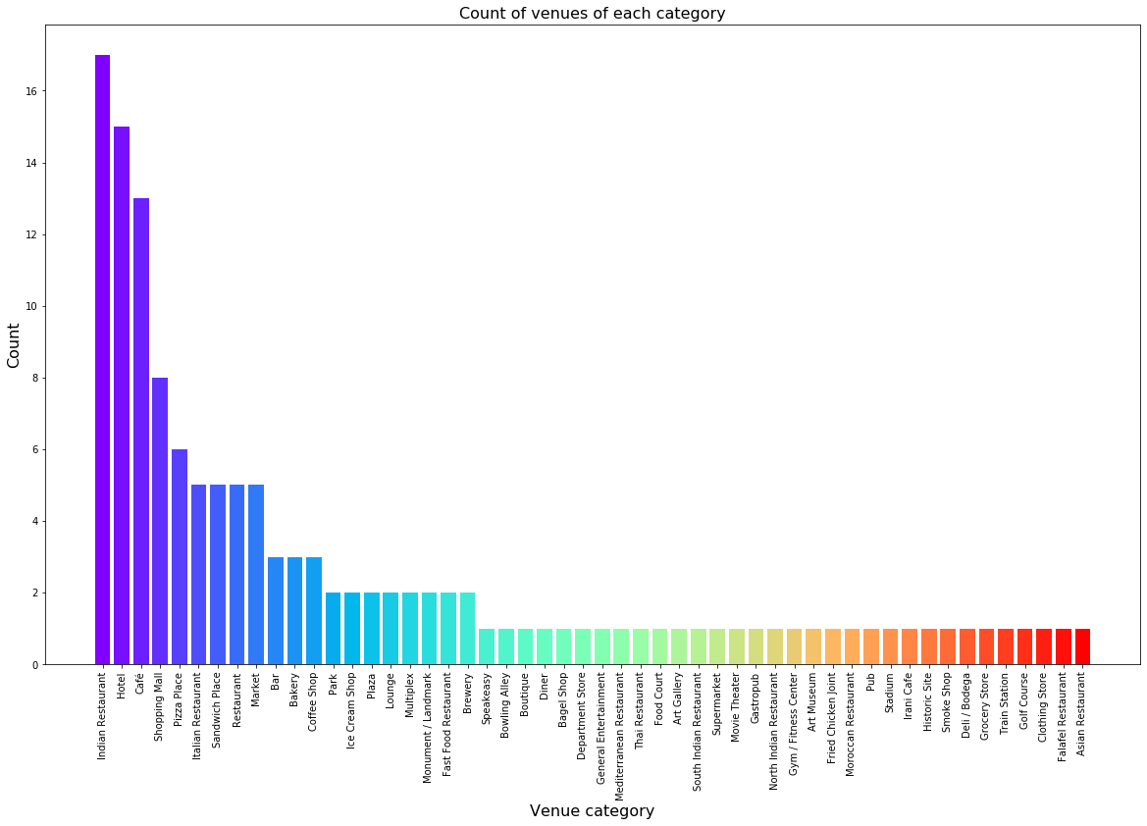

Slide 6
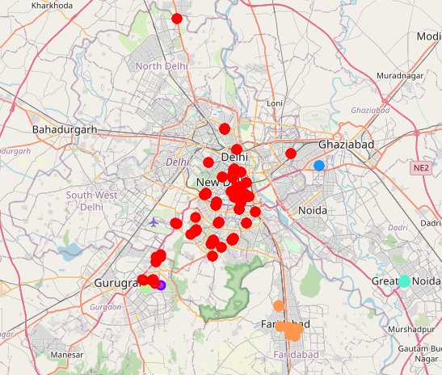
Result
Delhi region has the most similar cluster with maximum number of venues, followed by Gurgaon and Faridabad.

Slide 7
Conclusion
Based on the results, it is evident that Delhi and Gurgaon are ideal location for setting up oof any new complex.
.

